Slide 1
NYC Real Estate Agency
Zillow Data
Presenter: Adam Chang

Slide 2
Goal
What are the best zip codes in New York City?
Largest Return on Investment
Minimal Risk

Slide 3
Approach
Compare each level of area
Primary focus is within New York City
Find top 3 counties in New York City
Find top 3 zip codes in each county
Country: USA
State: New York
City: New York City
County: Manhattan
Zip Code: 10021

Slide 4
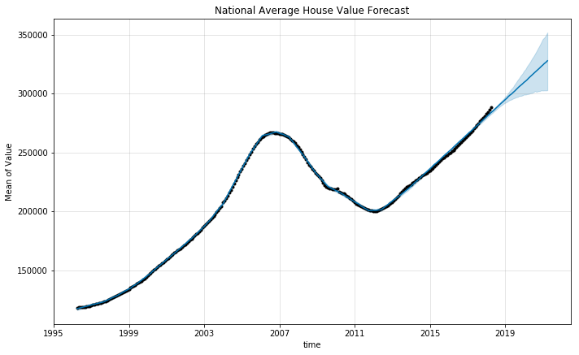
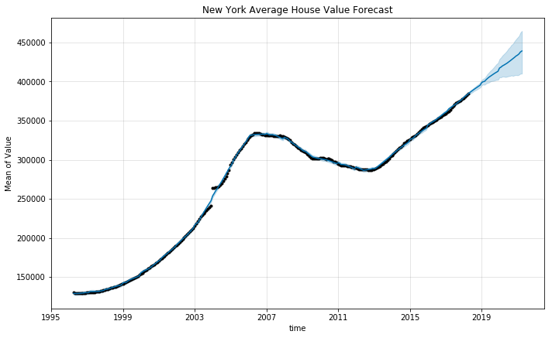
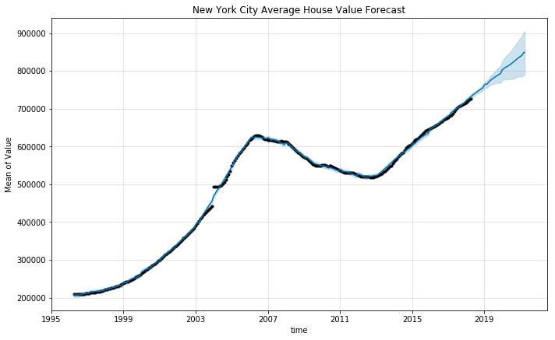
Forecast
Uncertainty Value – 80%
Periods – 36
Frequency – Monthly
13.8% increase from 2018 to 2021
14.3% increase from 2018 to 2021
16.9% increase from 2018 to 2021

Slide 5
Findings
Top 3 NYC Counties are…
County | % Increase by 2021 | Top Zip Code | % Increase by 2021
Manhattan | 31.1% | 10021 | 38.5%
Brooklyn | 26.6% | 11222 | 40.8%
Queens | 19.2% | 11104 | 32.9%

Slide 6
Conclusion
Out of top 5 NYC zip codes; 4 in Brooklyn, 1 in Manhattan
Out of top 10 NYC zip codes; 6 in Brooklyn, 3 in Queens, 1 in Manhattan
1 in Manhattan average price is 17.9 million in April 2018
Investing in the top 5 zip codes in 2018 will result in increase of 30 – 46%

Slide 7
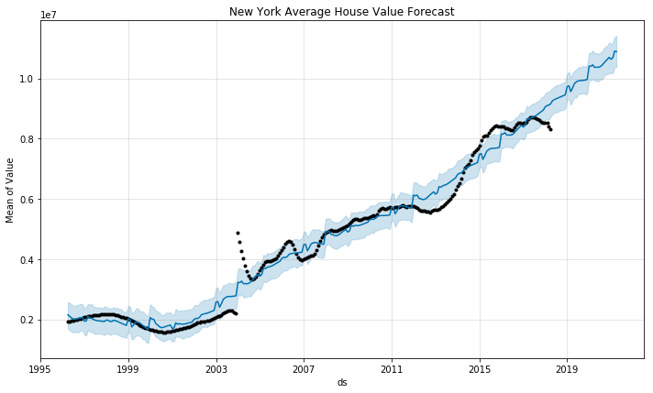
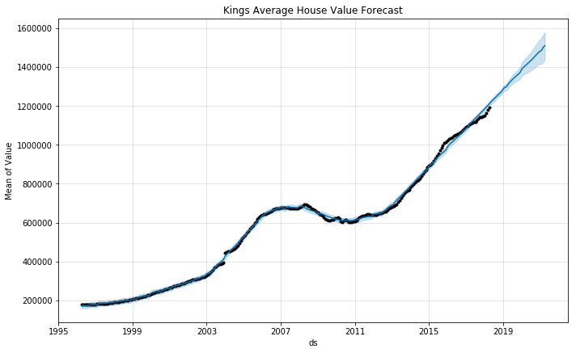
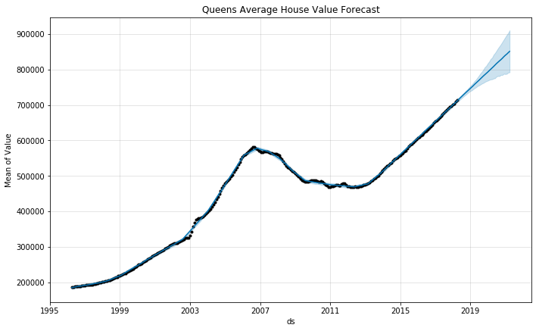
Recommendations
Focus on the top 5 zip codes of Brooklyn and top 5 zip codes of Queens
Avoid Manhattan because of price and fluctuations
If possible, focus on other cities. San Antonio, Texas
Manhattan
Brooklyn
Queens

Slide 8
Thank you

